Slide 1


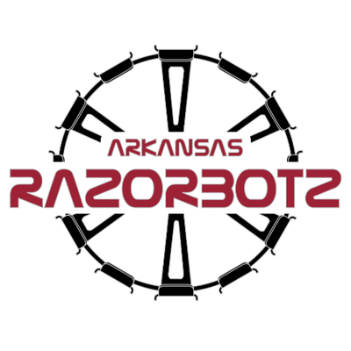
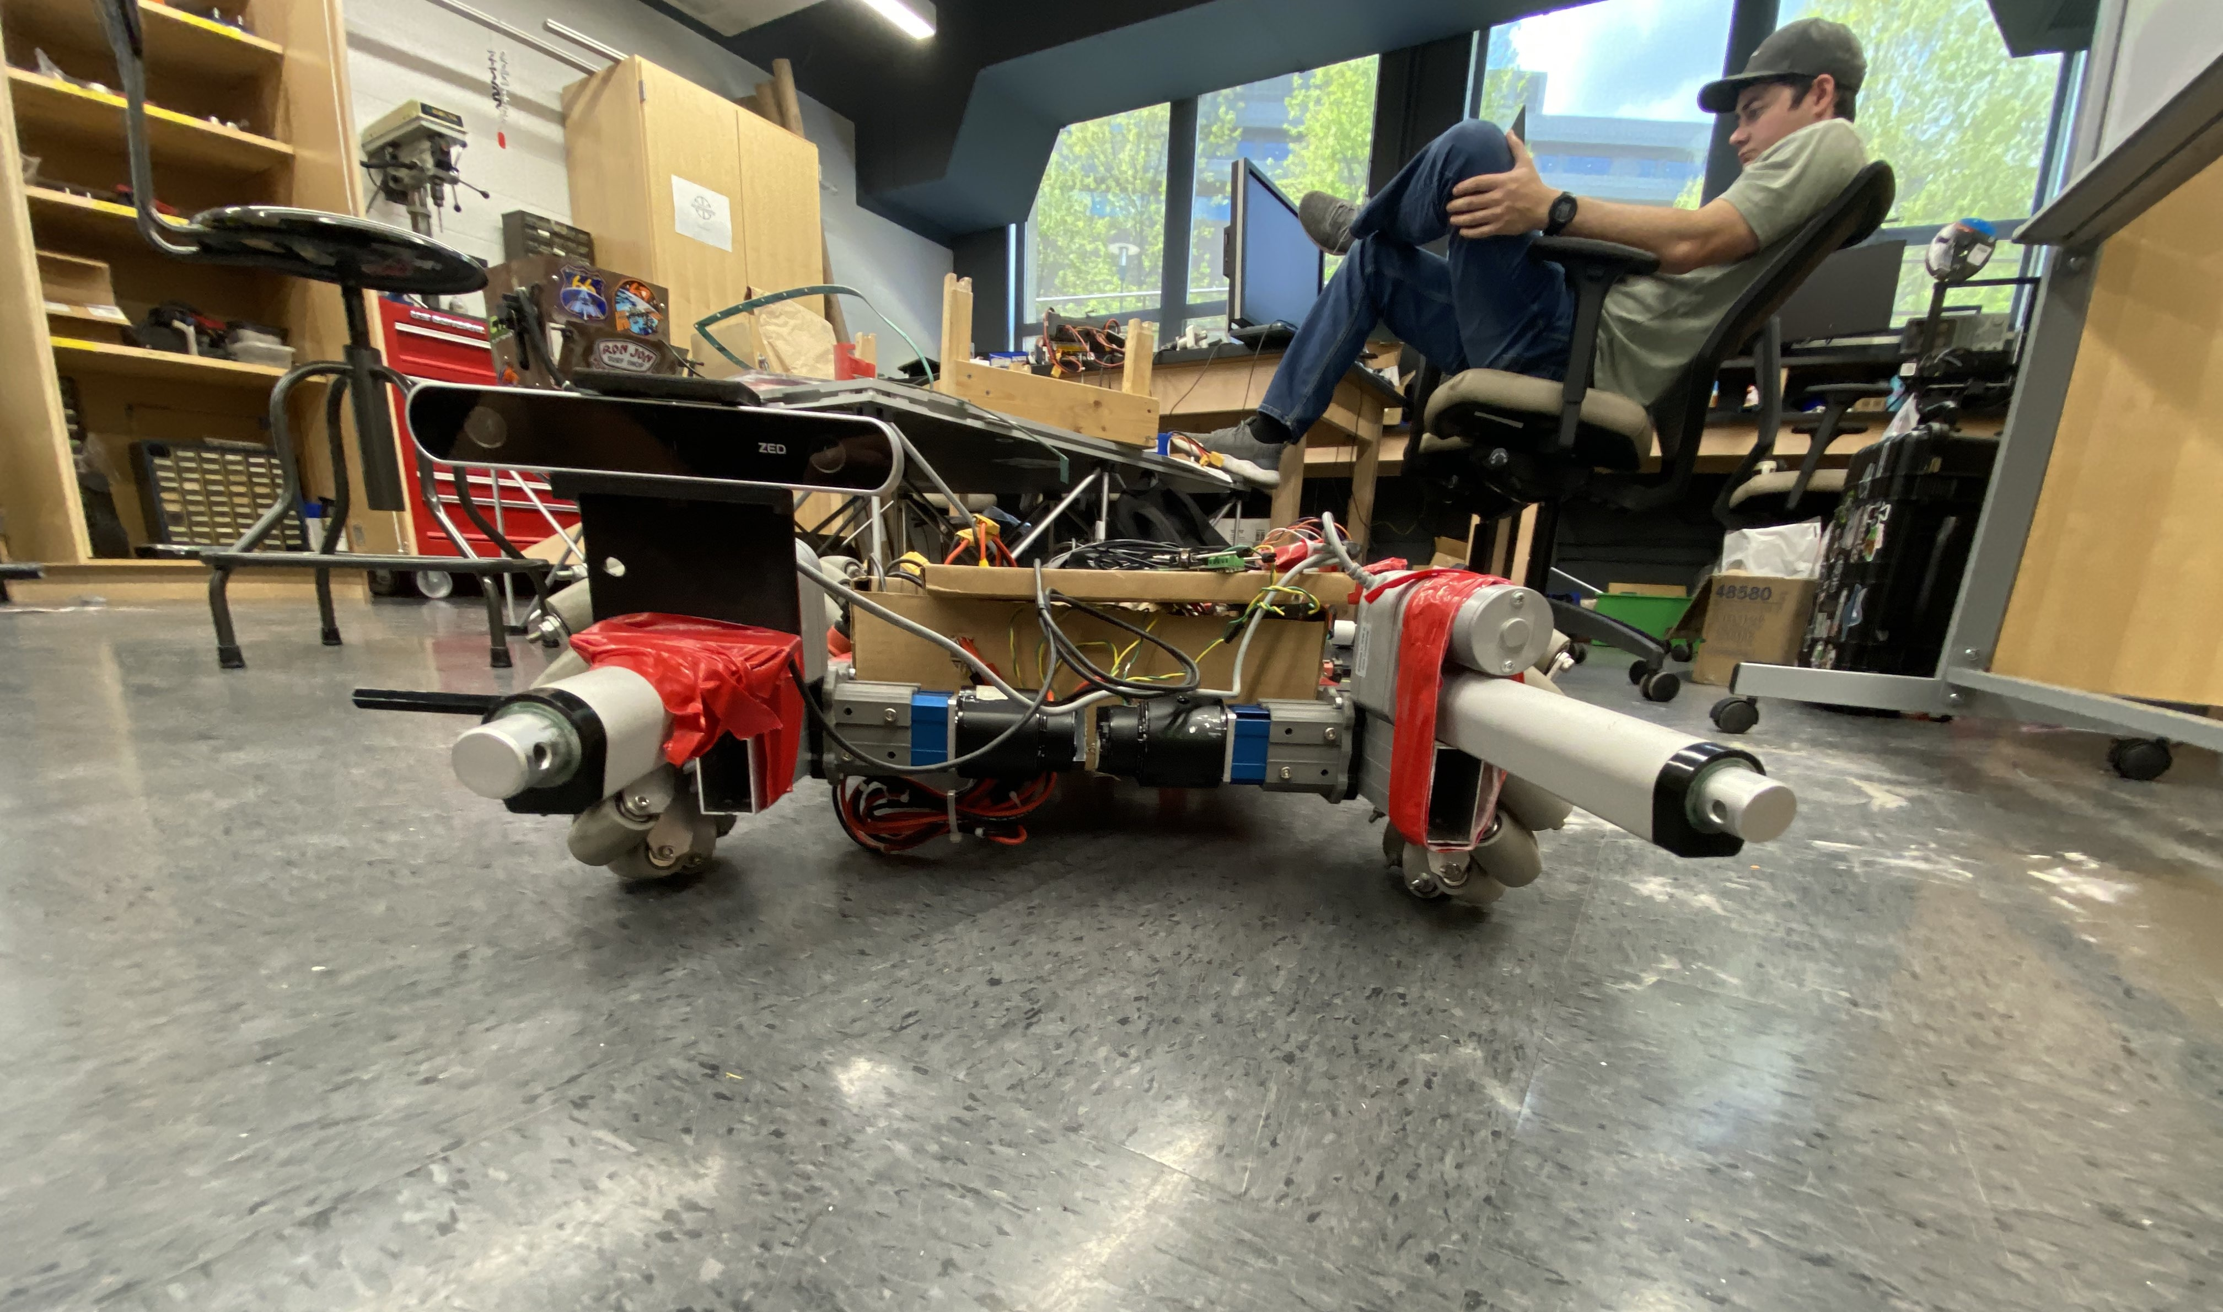
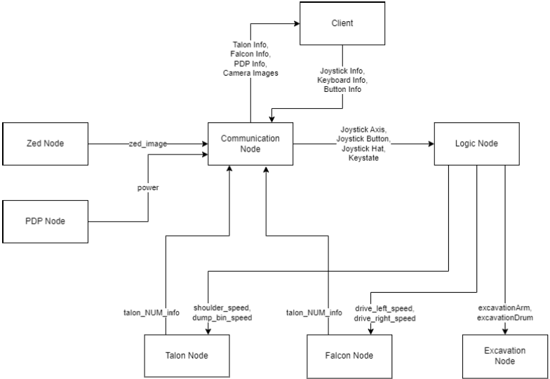
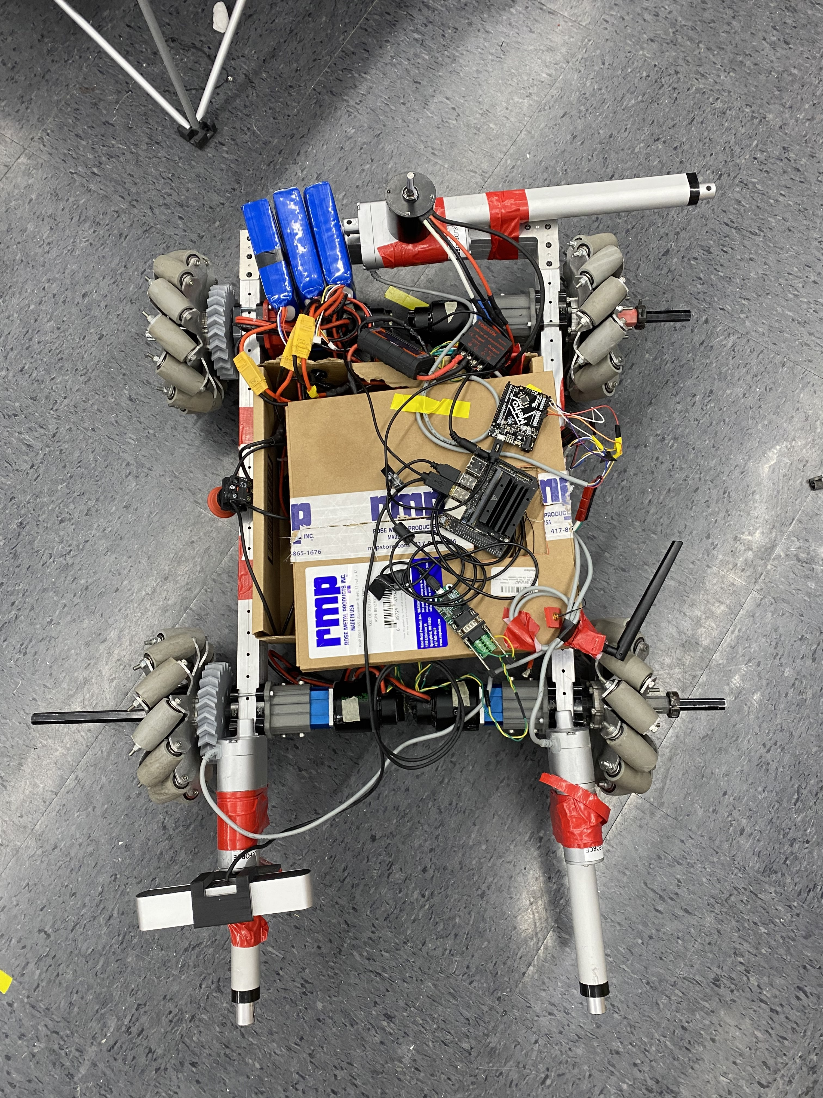
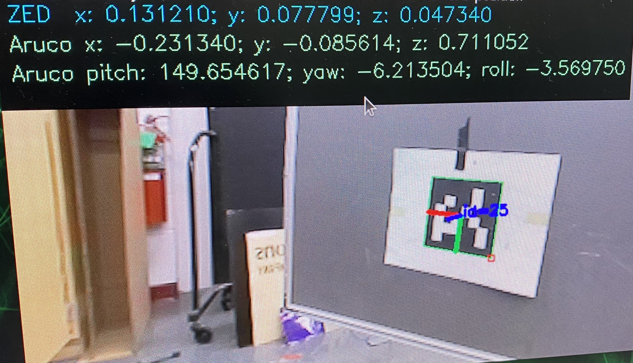
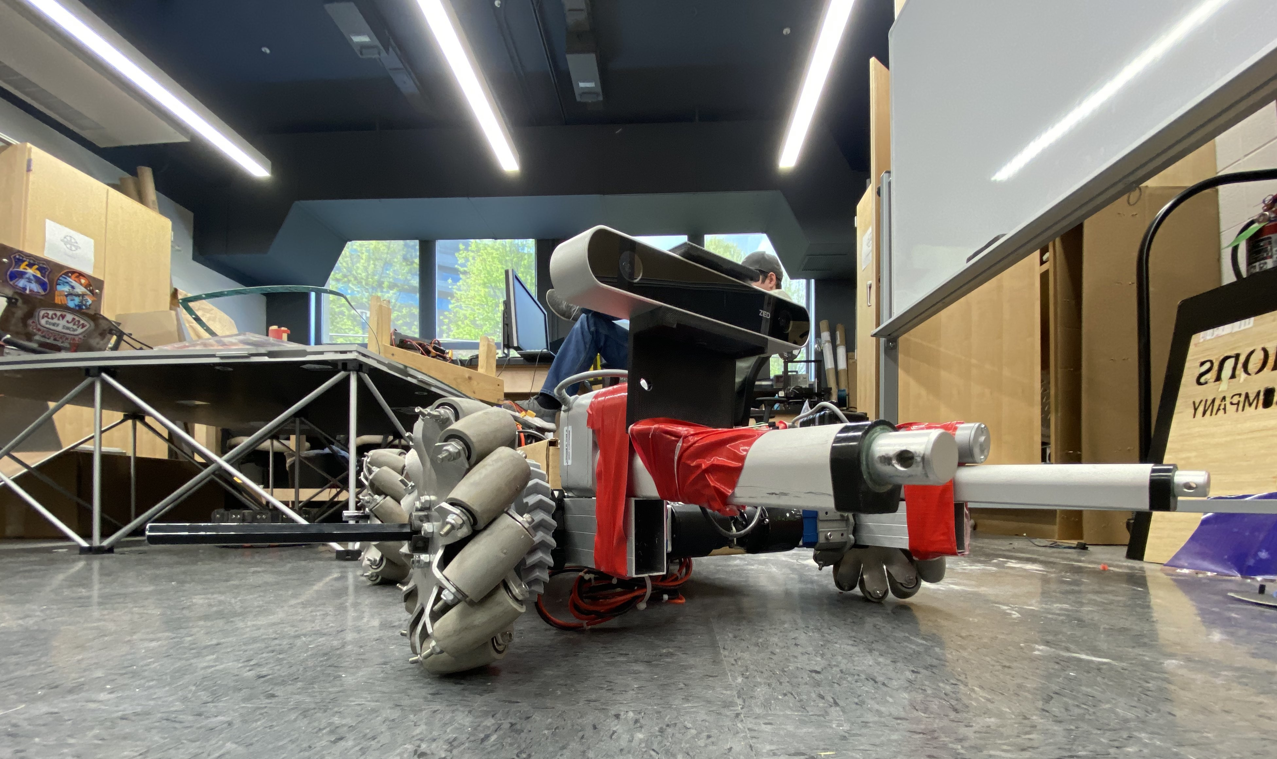
NASA Lunabotics Competition
CSCE: Ahmed Moustafa, Jackson Burger, Jackson Newman, Justin Kilgo, & Rohit Kala
MEEG: Shane Allder, Chandler Dye, Kaili Henry, Ryan McGuinness-Correa, Matthew Norris, Venkata Panabakam, Lauren Skartvedt, & Shel-Twon Warren
Sponsors: Dr. Uche Wejinya & Andrew Burroughs
Introduction
Automation
Challenges/Roadblocks
To sustain the growing population, NASA's Artemis program seeks resources off-planet, with the moon being a prime candidate. However, human travel to the moon is both dangerous and expensive, necessitating the development of efficient robots for mining and research. This is where the Lunabotics competition comes in, aiming to design a semi-autonomous lunar excavator that can maneuver through rough terrain and extract regolith. The team will integrate advanced sensors, robust software, and hardware components to achieve this objective safely and reliably.
To ensure that the robot is autonomous, we will primarily use the information that comes from the robot’s ZED camera. The camera tracks various information such as the X, Y, and Z coordinates as well as the roll, pitch, and yaw of the robot in addition to the video stream from the camera. We split up the automation of the robot into Driving and Excavation autonomies.
There were many adversities we faced coming into this project. The largest challenge in the software development process was having to alter the CSCE schedule and tasks to meet the delays in MEEG robot construction. Taking this into account, we had to take a different approach and focus on code we could complete without the robot at first. This pre-requisite code would help with the development of the Autonomy code.
Once we had portions of the physical robot we had instances of mechanical failure including shattering a gearbox and shearing a motor mount which caused further delays.
Driving
The driving autonomy of the robot consists of the following:
The robot rotates until it locates an ArUco marker using the OpenCV library as well as the ZED camera.
Once this marker is found, the robot rotates 90° to orient itself with the excavation zone.
The robot then drives 1 meter forward to get to the excavation zone.
It then calls upon the excavation automation to extract the material.
After excavating the material, the robot rotates 180° to orient and drive itself to the dumping zone.
The robot then dumps the material.
Manual Control
The Communication node is a central element of the Lunabotics excavator's software architecture that takes in data from other nodes and publishes data through rclcpp APIs to move the robot based on user input. It relies on other nodes such as Client, Logic, Excavation, Falcon, Talon, Zed, and the Power Distribution Panel for data.
The Client transmits joystick information, and the Zed node publishes images to calculate the robot’s position and detect obstacles. The Logic node updates the wheel and excavation motor speeds based on real-time information from the Communication node. The Falcon and Talon nodes control motor controllers responsible for vertical motion and height control of the excavation apparatus and bucket system. Lastly, the Excavation node controls the system, allowing for controller input and autonomous excavation macros.
Results
After two semesters of work, we successfully created a semi-autonomous rover that can fully drive. Our CSCE sub-team delivered C++ code for ROS2 Nodes that enable Manual Joystick Control and Autonomous Driving.
Unfortunately, due to delays in the Excavation hardware construction, we were unable to demonstrate our excavation autonomy code. However, our code is accessible on the 2022-23 Razorbotz GitHub repository.
Excavation
The excavation autonomy is called when the robot arrives at the extraction zone where the regolith is located. The robot uses linear actuators to lower a drum that spins to extract the material. This material is deposited onto a conveyor belt which delivers it to a storage bucket.
Figure 1: Flowchart of ROS2 Nodes
Figure 2: ZED Camera display for ArUco marker detection

